Slide 1

The lecture 14
Sentiment analysis

Slide 2


Sentiment analysis
In recent years, the development of the Internet has led to a significant increase in a number of news sites and social networks that describe various events in the world
People actively share their opinions and comments on different topics such as sport, politics, movies, music and so on. The result is a huge amount of available unstructured information
Tracking and analyzing manually such volumes of information is not possible
Published articles and user comments in most cases are of a certain emotional aspect
Here we observe sentiment analysis with the use of machine learning algorithms and convolutional and recurrent neural networks (CNN and RNN)
The obtained results are compared with each other

Slide 3


Sentiment analysis
People’s attitude towards significant events is very important
It is required to understand how the perception of various events and interaction of users with each other occur
It also allows to determine the most important problems that government agencies need to pay more attention to
In Kazakhstan publications of texts and user comments are presented in such popular news portals as Zakon.kz, Nur.kz, Vlast.kz, Tengrinews.kz, etc. and social networks: VK, Facebook, Twitter and Instagram
Gaining huge volumes of data allows to realize automatic sentiment analysis

Slide 4
Datasets
Data for the classifier were gathered with the use of web-crawler in OMSystem, an analytical platform of monitoring Kazakhstan media space
This application has been developed at al-Farabi Kazakh National University
Texts and comments have been collected from news portals: Tengrinews.kz, Zakon.kz, Nur.kz, Informburo.kz, Times.kz, Today.kz, etc.
They were labeled as positive and negative
Then they were equally balanced
The number of texts and comments is 1040 and 7514 for Russian, and 434 and 346 for Kazakh, respectively

Slide 5
Data preprocessing
In order to apply machine learning algorithms texts were preprocessed with the following steps
For Russian words, SnowballStemmer from the NKTL library in the Python programming language has been used
For Kazakh words, new Kazakh_Stemmer has been developed
There is a database of suffixes and endings of the Kazakh language
Preprocessing
Remove extra characters and punctuation marks
Remove
stop words
Stemming

Slide 6
Text vectorization
For text vectorization TF-IDF metric and pretrained FastText word embedding
TF-IDF metric is represented as follows
where is a number of times a word w is found in a document d, and is the total number of words N in the document d
where is the total number of documents, is d

Slide 7
Classification with ml algorithms
Classification is done with the list of the most widespread machine learning algorithms: Logistic regression, Naïve Bayes classifier, Support vector machine (SVM), K-nearest neighbors, Decision tree and Random forest
Naive Bayes classifier is a very easy and effective vector analysis method that shows results no worse than other more complex classifiers. This classifier is based on the conditional probability, according to which the document d belongs to the class c, and uses the Bayes formula. For a text analysis model, the following formula is used

Slide 8
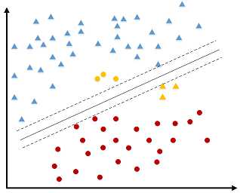
SVM
In Support vector machine, a hyperplane that divides the dataset into two classes: positive and negative. This hyperplane is given by the following formula:

Slide 9
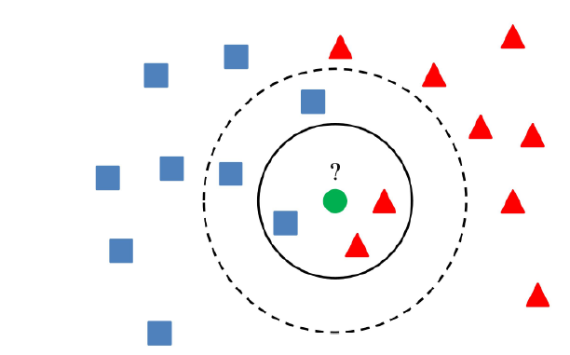
K-nearest neighbors
The K-nearest neighbors method allows you to classify documents using the Euclidean space, which determines the distance between two vectors

Slide 10
Decision tree and random forest
Decision trees are a fast way to classify data. It is a structure with k-nodes in which a test is performed on the features of data
When constructing a decision tree, the following rules are applied
A word is selected, and the documents containing it are put on one side, and the documents not containing it are put on the other side
Thus, the documents belong to two disjoint sets
Random forests or random decision forests technique is an ensemble learning method for text classification
The document is classified by all trees, and its class is determined by the highest number of trees voted for it

Slide 11
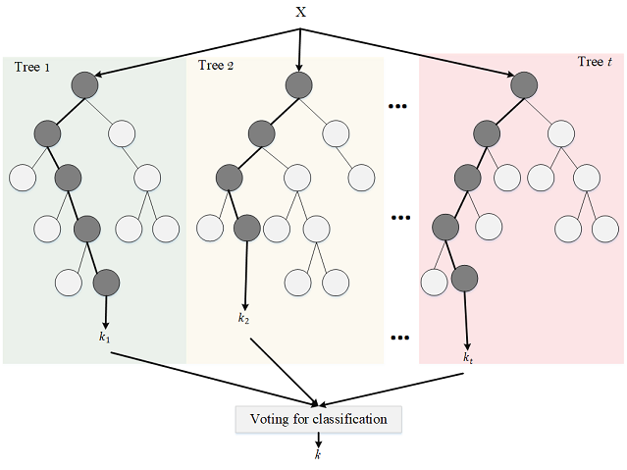
Random forest

Slide 12
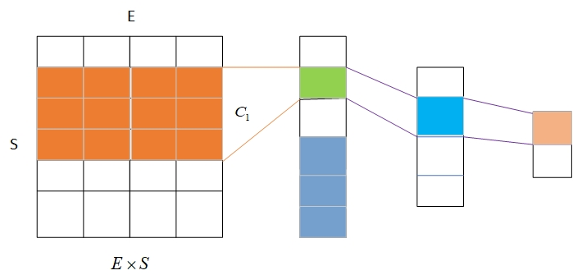
Classification with CNN
To apply CNN, it is necessary to cut off sentences that are too long or to supplement ones that are too short
In order to do it, we define S as a maximum length of the sentence. When converting, we get a vector of a word of dimension E
Vectorization is performed using the fastText model. In the matrix, semantically close words are next to each other, and words with different meanings are far away
Next, the first filter is applied to the matrix
The scalar product of the matrix and filter elements is performed. The result value is transferred to the next layer. As a result of transformations, vectors of smaller sizes are obtained
At the end of the transformations, the text is classified as positive or negative

Slide 13
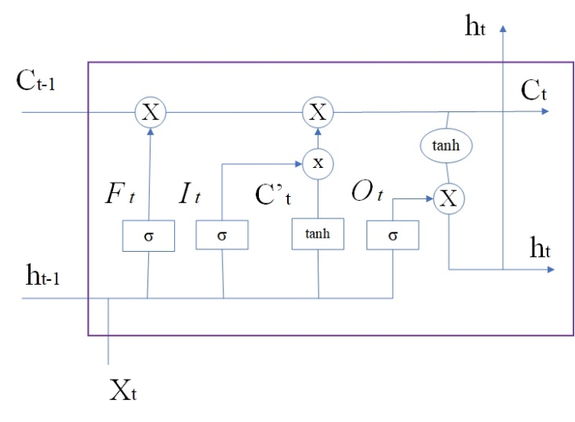
Classification with RNN
One of the most popular RNN models is LSTM
The network structure includes 4 parts: the output gate O_{t}, the forget gate F_{t}, the memory cell C_{t} and the input gate I_{t}
All three gates take the input of the current time interval and the output of the past time interval
New data come in through F_{t} and I_{t}
The O_{t} output for the current interval is generated by the system
The architecture of LSTM is presented below

Slide 14
Experimental results
The text data is divided into train 80% and test 20%
Each of the machine learning algorithms is applied to the vectorized data
To evaluate the results, the test on the remaining 20% of the data is implemented
Accuracy, precision, recall and F-measure metrics were used
Graphics of ROC curves were built

Slide 15
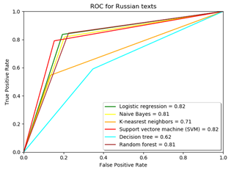
Metrics of classification algorithms for Russian texts
Algorithm | Accuracy | Precision | Recall | F-measure
Logistic regression | 0.82 | 0.83 | 0.84 | 0.83
Naïve Bayes | 0.81 | 0.82 | 0.82 | 0.82
K-nearest neighbors | 0.7 | 0.82 | 0.55 | 0.66
Support vector machine | 0.82 | 0.85 | 0.79 | 0.82
Decision tree | 0.66 | 0.68 | 0.68 | 0.68
Random forest | 0.82 | 0.81 | 0.86 | 0.83

Slide 16
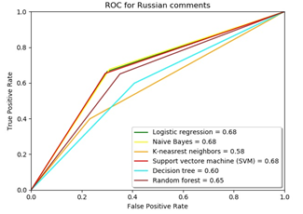
Metrics of classification algorithms for Russian comments
Algorithm | Accuracy | Precision | Recall | F-measure
Logistic regression | 0.68 | 0.68 | 0.66 | 0.67
Naïve Bayes | 0.68 | 0.67 | 0.68 | 0.68
K-nearest neighbors | 0.58 | 0.62 | 0.4 | 0.48
Support vector machine | 0.68 | 0.69 | 0.65 | 0.67
Decision tree | 0.6 | 0.58 | 0.62 | 0.6
Random forest | 0.65 | 0.63 | 0.64 | 0.64

Slide 17
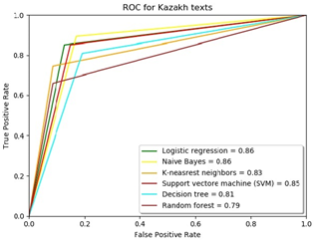
Metrics of classification algorithms for Kazakh texts
Algorithm | Accuracy | Precision | Recall | F-measure
Logistic regression | 0.86 | 0.87 | 0.85 | 0.86
Naïve Bayes | 0.86 | 0.84 | 0.89 | 0.87
K-nearest neighbors | 0.83 | 0.9 | 0.74 | 0.81
Support vector machine | 0.85 | 0.85 | 0.85 | 0.85
Decision tree | 0.82 | 0.83 | 0.8 | 0.81
Random forest | 0.81 | 0.9 | 0.7 | 0.79

Slide 18
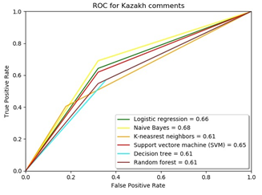
Metrics of classification algorithms for Kazakh comments
Algorithm | Accuracy | Precision | Recall | F-measure
Logistic regression | 0.66 | 0.75 | 0.64 | 0.69
Naïve Bayes | 0.69 | 0.76 | 0.69 | 0.73
K-nearest neighbors | 0.57 | 0.77 | 0.4 | 0.53
Support vector machine | 0.64 | 0.74 | 0.62 | 0.68
Decision tree | 0.57 | 0.69 | 0.52 | 0.59
Random forest | 0.61 | 0.74 | 0.55 | 0.63

Slide 19
Classification with CNN
To classify texts and comments using neural networks, data is vectorized using the fastText model
Then data are divided into train 60%, validation 20%, and test 20% parts
In the CNN, three convolutional layers, one pooling layer, and one dropout layer are used
Since there is not much data for classification, 3-5 epochs are enough to avoid overfitting

Slide 20
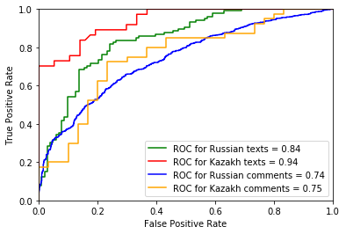
Metrics of texts and comments classification with CNN
Metrics | Russian texts | Russian comments | Kazakh texts | Kazakh comments
Accuracy | 0.79 | 0.68 | 0.86 | 0.7
Precision | 0.77 | 0.66 | 0.93 | 0.79
Recall | 0.83 | 0.68 | 0.7 | 0.65
F-measure | 0.8 | 0.67 | 0.8 | 0.71

Slide 21
Classification with RNN
Then, classification with LSTM was realized.
Data were divided into train 60%, validation 20%, and test 20% parts.
Two hidden layers, two fully connected layers, and one dropout layer were used.
As LSTM neural network works longer, 10-20 epochs were put in the training process.

Slide 22
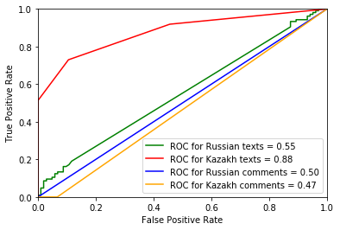
Metrics of texts and comments classification with LSTM
Metrics | Russian texts | Russian comments | Kazakh texts | Kazakh comments
Accuracy | 0.52 | 0.48 | 0.8 | 0.42
Precision | 0.8 | 0.48 | 1 | 0.01
Recall | 0.08 | 1 | 0.49 | 0.01
F-measure | 0.14 | 0.65 | 0.65 | 0.01

Slide 23
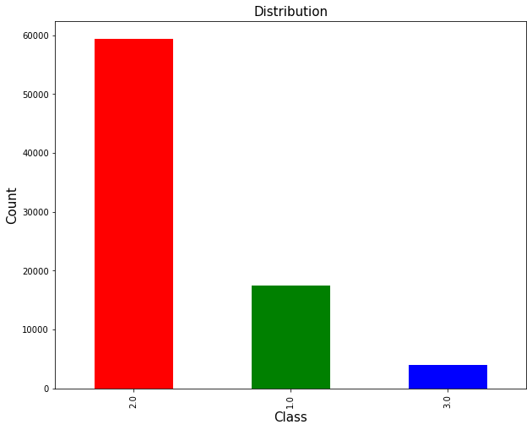
Multiclass text classification

Slide 24
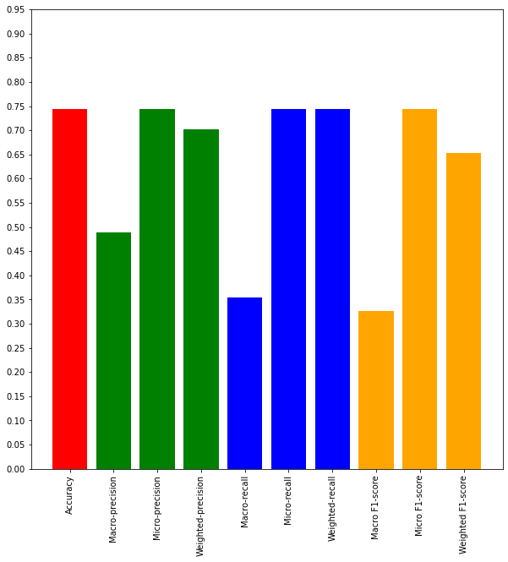
Classification with ML algorithms
Unbalanced classes
Naïve Bayes classifier

Slide 25
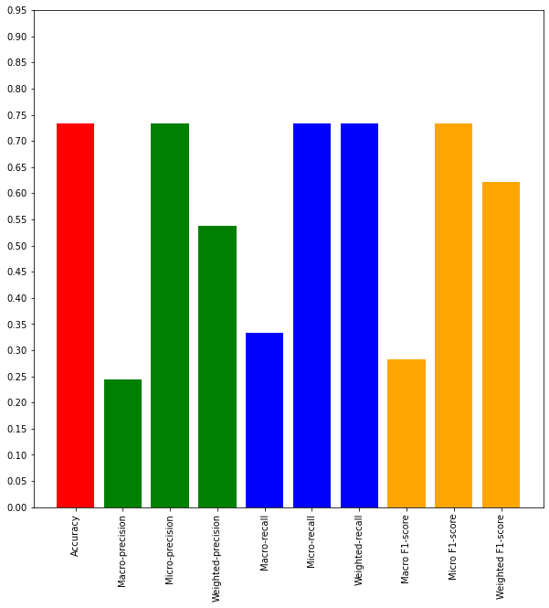
Classification with ML algorithms
Support vector machine

Slide 26
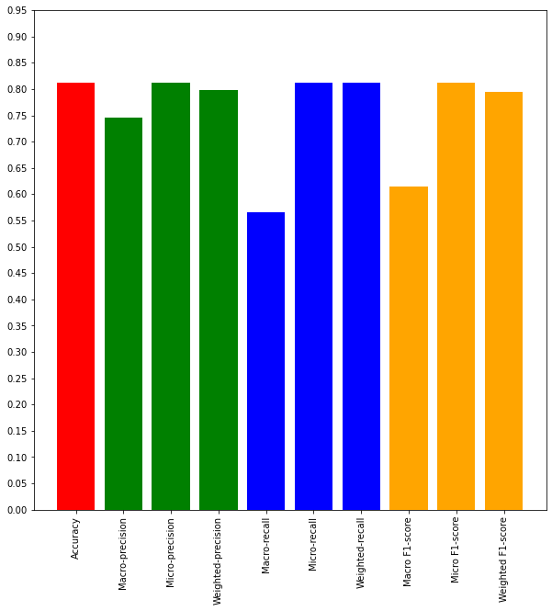
Classification with ML algorithms
Logistic regression

Slide 27
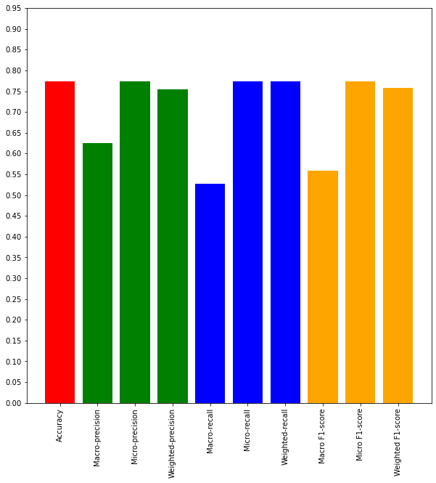
Classification with ML algorithms
K-nearest neighbors

Slide 28
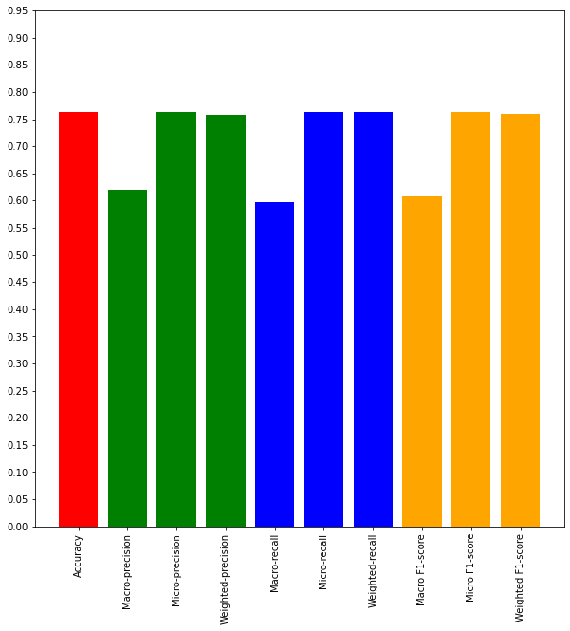
Classification with ML algorithms
Decision tree

Slide 29

Classification with ML algorithms
Random forest

Slide 30
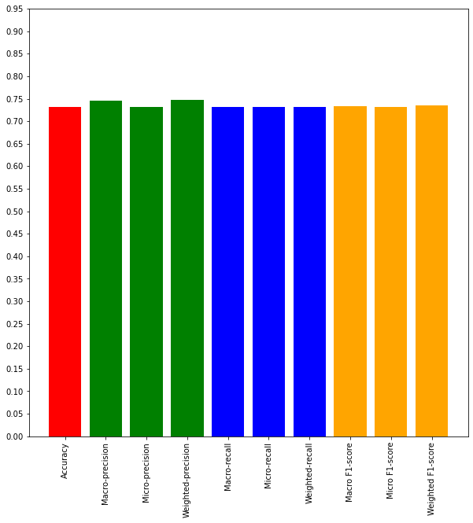
Classification with ML algorithms
Balanced classes
Naïve Bayes classifier

Slide 31
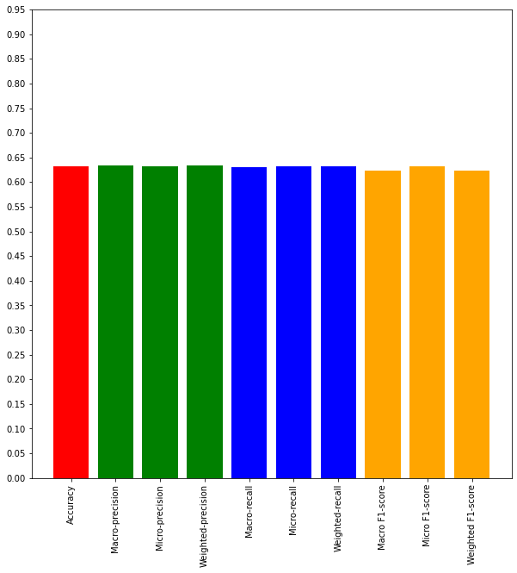
Classification with ML algorithms
Support vector machine

Slide 32
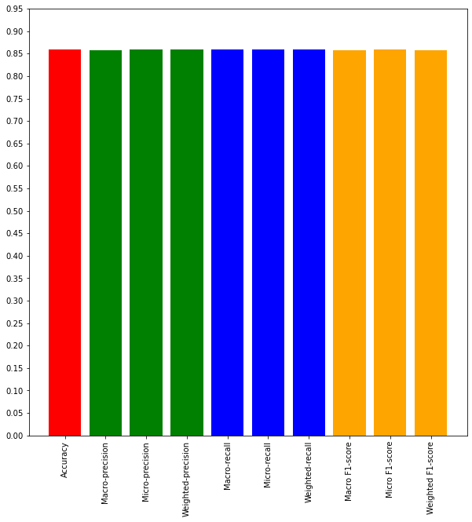
Classification with ML algorithms
Logistic regression

Slide 33
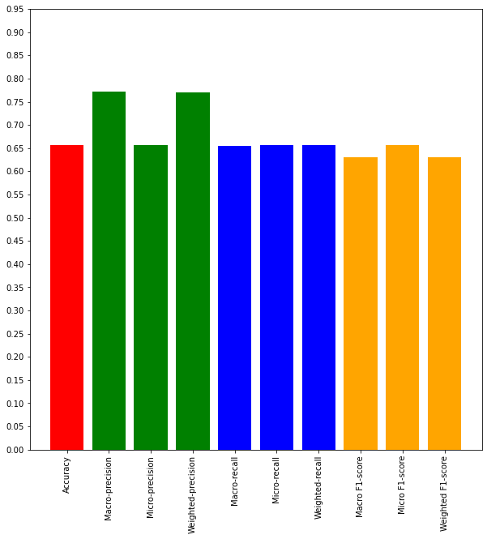
Classification with ML algorithms
K-nearest neighbors

Slide 34
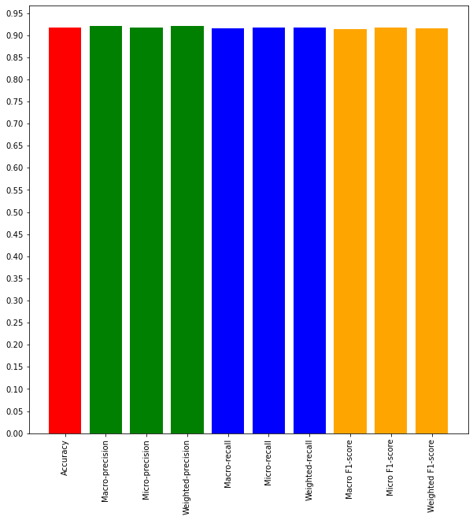
Classification with ML algorithms
Decision tree

Slide 35
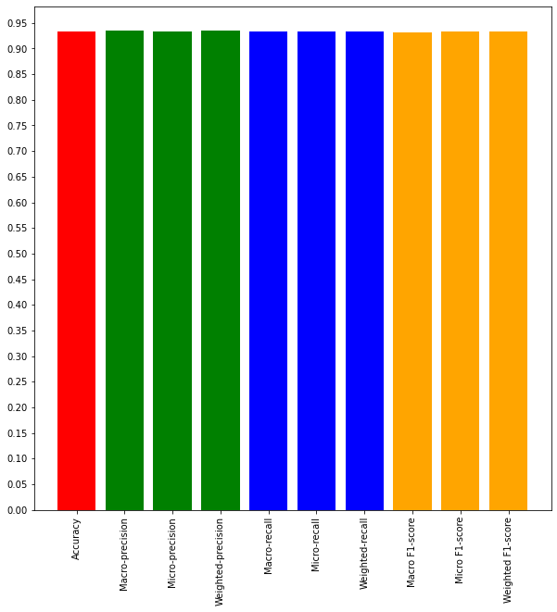
Classification with ML algorithms
Random forest

